Slide 1
Loan a pound

Slide 2
Basic architecture
Database
Backend
User Interface

Slide 3
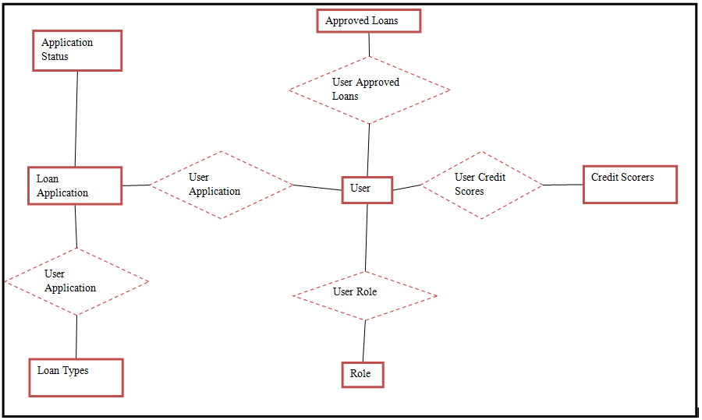
Data Model

Slide 4
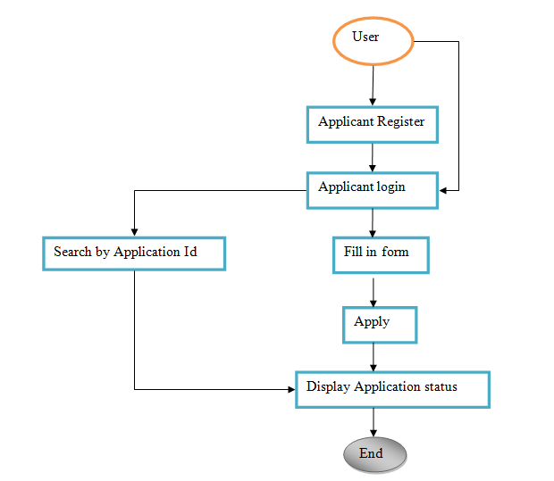
User Workflow

Slide 5
Test case for USER WORKFLOW - P1
User registration
Validate mandatory fields (email id, name, dob, address, password)
Validate weak and strong password
Validate password characters
Validate address exists
Validate DOB
Validate new user by email ID
User login
Validate email is registers. If not prompt for registration
Validate all pages have logout option if logged in or login option if logged out

Slide 6
Test case for USER WORKFLOW – P2
User Login cont....
Validate password characters
Validate maximum number of invalid login to lock the account
Validate login redirection page is correct
Search application
Validate charters for application reference ID

Slide 7
Fill in application form
Validate all necessary fields are displayed
Validate all mandatory fields
Validate all the characters entered in the fields are correct
Apply
Validate page redirection to application status
Display application status
Validate the newly registered application status is displayed

Slide 8
Tools used
Java as main programming language
Maven as the build tool
Spring boot framework to build the application and its container
Mysql database (using hibernate mapping)
Junit and Mockito for unit testing
SpringBootTest for Integration Test Support

Slide 9
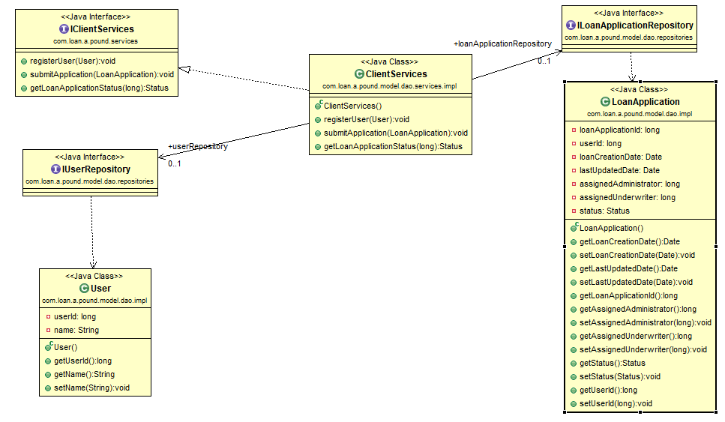
Client Services UML

Slide 10
Deployment
Installation MYSQL on unix https://dev.mysql.com/doc/refman/5.7/en/binary-installation.html
Installation on windows https://dev.mysql.com/doc/refman/5.7/en/windows-installation.html
Running the jar (spring boot compiles the servlet as well): java –jar loan-a-pound-0.0.1-SNAPSHOT.jar

